Slide 1

Chapter 8
Dynamic Programming
Copyright © 2007 Pearson Addison-Wesley. All rights reserved.

Slide 2
Dynamic Programming
Dynamic Programming is a general algorithm design technique
for solving problems defined by recurrences with overlapping
subproblems
Invented by American mathematician Richard Bellman in the 1950s to solve optimization problems and later assimilated by CS
“Programming” here means “planning” (not computer programming)
Main idea:
    set up a recurrence relating a solution to a larger instance to solutions of some smaller instances
    - solve smaller instances once
    record solutions in a table
    extract solution to the initial instance from that table

Slide 3
Example: Fibonacci numbers
Recall definition of Fibonacci numbers:
  F(n) = F(n-1) + F(n-2)
  F(0) = 0
  F(1) = 1
Computing the n^{th} Fibonacci number recursively (top-down):
F(n)
F(n-1) + F(n-2)
F(n-2) + F(n-3) F(n-3) + F(n-4)
...

Slide 4
Example: Fibonacci numbers (cont.)
  Computing the n^{th} Fibonacci number using bottom-up iteration and recording results:
F(0) = 0
F(1) = 1
F(2) = 1+0 = 1
…
F(n-2) =
F(n-1) =
F(n) = F(n-1) + F(n-2)
Efficiency:
- time
- space

Slide 8
Examples of DP algorithms
Computing a binomial coefficient
Warshall’s algorithm for transitive closure
Floyd’s algorithm for all-pairs shortest paths
Constructing an optimal binary search tree
Some instances of difficult discrete optimization problems:
  - traveling salesman
  - knapsack

Slide 9
Computing a binomial coefficient by DP
  Binomial coefficients are coefficients of the binomial formula:
  (a + b)^{n} = C(n,0)a^{n}b⁰ + . . . + C(n,k)a^{n-k}b^{k} + . . . + C(n,n)a⁰b^{n}
  Recurrence: C(n,k) = C(n-1,k) + C(n-1,k-1) for n > k > 0
  C(n,0) = 1, C(n,n) = 1 for n ≥ 0
  Value of C(n,k) can be computed by filling a table:
  0 1 2 . . . k-1 k
  0 1
  1 1 1
  .
  .
  .
  n-1 1 C(n-1,k-1) C(n-1,k)
  n 1 C(n,k)

Slide 10
Computing a binomial coefficient by DP
  Value of C(n,k) can be computed by filling a table:
  0 1 2 3 4 5. . . k-1 k
  0 1
  1 1 1
  2 1 2 1
  3 1 3 3 1
  4 1 4 6 4 1
  5 1 5 10 10 5 1 [Pascal’s triangle]
  . 1
  . 1
  . 1
  n-1 1 C(n-1,k-1) C(n-1,k)
  n 1 C(n,k)

Slide 11
Pascal’s Triangle
1
1
1 2 1
1 3 3 1
1 4 6 4 1
5 10 10 5 1
…

Slide 12
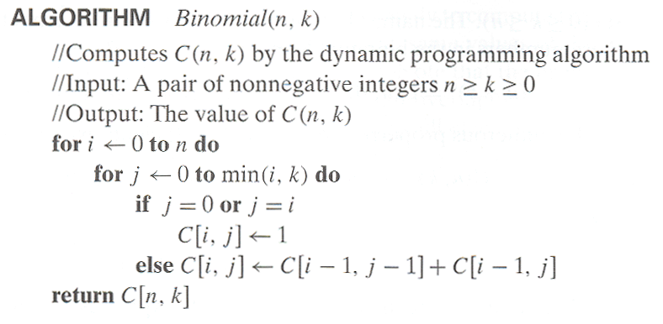
Computing C(n,k): pseudocode and analysis
Time efficiency: Θ(nk)
Space efficiency: Θ(nk)

Slide 13
Warshall’s Algorithm: Transitive Closure
Computes the transitive closure of a relation
Alternatively: existence of all nontrivial paths in a digraph
Example of transitive closure:
3
3
1
1
4
4
0 0 1 0
1 1 1 1
0 0 0 0
1 1 1 1
2
0 0 1 0
1 0 0 1
0 0 0 0
0 1 0 0
2

Slide 19
Warshall’s Algorithm
Constructs transitive closure T as the last matrix in the sequence of n-by-n matrices R⁽⁰⁾, … , R^{(k)}, … , R^{(n)} where
R^{(k)}[i,j] = 1 iff there is nontrivial path from i to j with only first k vertices allowed as intermediate
Note that R⁽⁰⁾ = A (adjacency matrix), R^{(n)} = T (transitive closure)
3
3
3
3
3
1
1
1
1
1
4
4
4
2
4
4
2
2
2
2
R⁽⁰⁾
0 0 1 0
1 0 0 1
0 0 0 0
0 1 0 0
R⁽¹⁾
0 0 1 0
1 0 1 1
0 0 0 0
0 1 0 0
R⁽²⁾
0 0 1 0
1 0 1 1
0 0 0 0
1 1 1 1
R⁽³⁾
0 0 1 0
1 0 1 1
0 0 0 0
1 1 1 1
R⁽⁴⁾
0 0 1 0
1 1 1 1
0 0 0 0
1 1 1 1

Slide 20
Warshall’s Algorithm (recurrence)
On the k-th iteration, the algorithm determines for every pair of vertices i, j if a path exists from i and j with just vertices 1,…,k allowed as intermediate
        R^{(k-1)}[i,j] (path using just 1 ,…,k-1)
R^{(k)}[i,j] = or
      R^{(k-1)}[i,k] and R^{(k-1)}[k,j] (path from i to k
      and from k to i
      using just 1 ,…,k-1)
{
k
i
j

Slide 21
Warshall’s Algorithm (matrix generation)
Recurrence relating elements R^{(k)} to elements of R^{(k-1)} is:
      R^{(k)}[i,j] = R^{(k-1)}[i,j] or (R^{(k-1)}[i,k] and R^{(k-1)}[k,j])
It implies the following rules for generating R^{(k)} from R^{(k-1)}:
Rule 1 If an element in row i and column j is 1 in R^{(k-1)},
it remains 1 in R^{(k)}
Rule 2 If an element in row i and column j is 0 in R^{(k-1)},
it has to be changed to 1 in R^{(k)} if and only if
the element in its row i and column k and the element
in its column j and row k are both 1’s in R^{(k-1)}

Slide 22
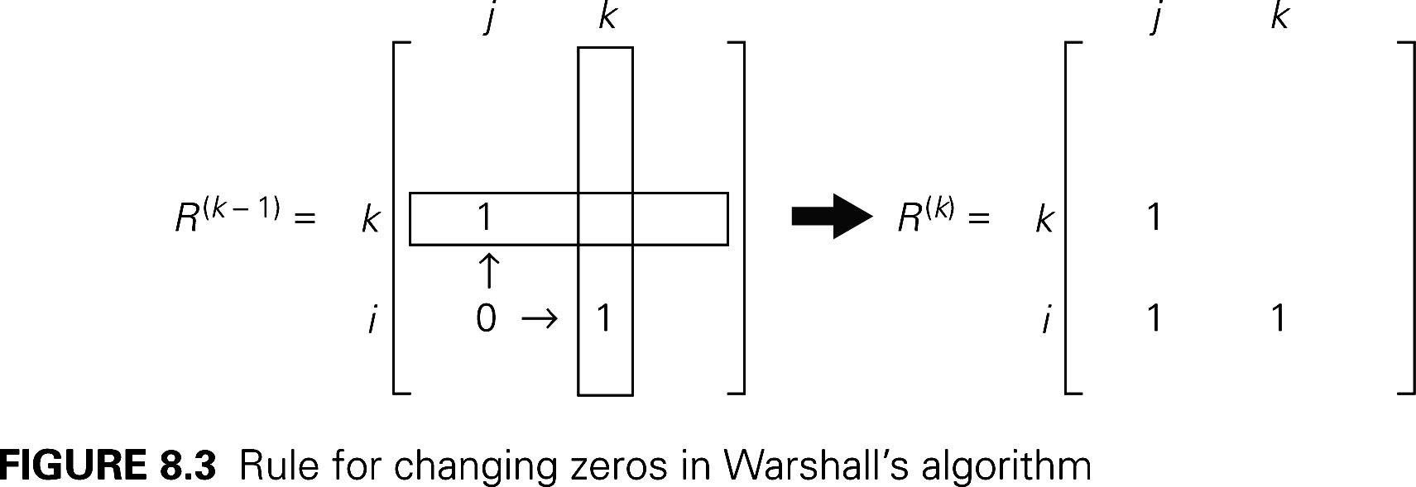

Slide 23

Warshall’s Algorithm (example)
3
0 0 1 0
1 0 0 1
0 0 0 0
0 1 0 0
0 0 1 0
1 0 1 1
0 0 0 0
0 1 0 0
1
R⁽⁰⁾ ⁼
R⁽¹⁾ ⁼
2
4
0 0 1 0
1 0 1 1
0 0 0 0
1 1 1 1
0 0 1 0
1 0 1 1
0 0 0 0
1 1 1 1
0 0 1 0
1 1 1 1
0 0 0 0
1 1 1 1
R⁽²⁾ ⁼
R⁽³⁾ ⁼
R⁽⁴⁾ ⁼

Slide 24
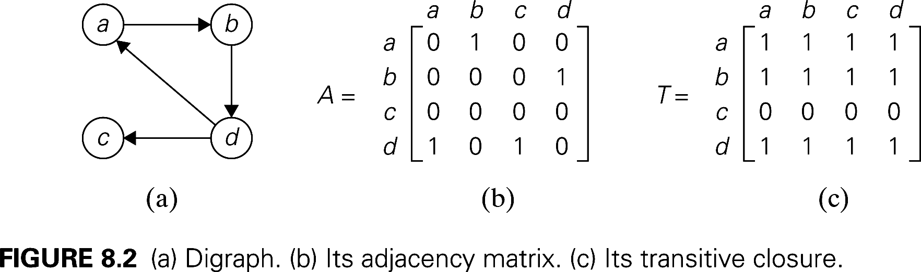

Slide 25
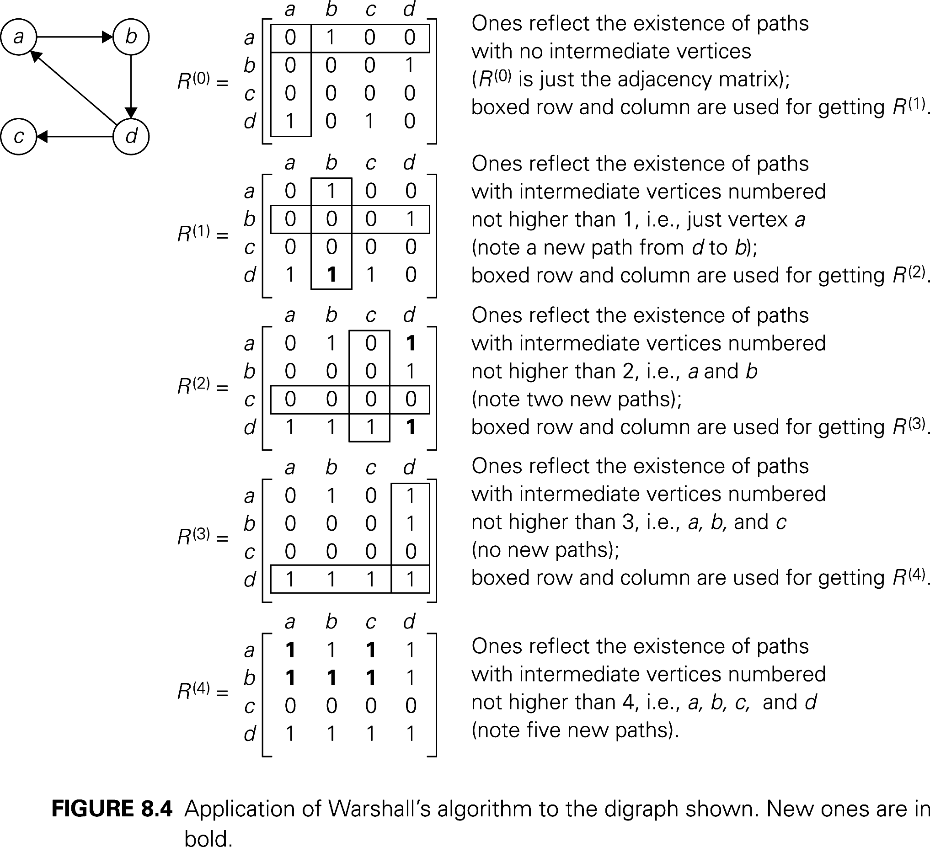

Slide 26
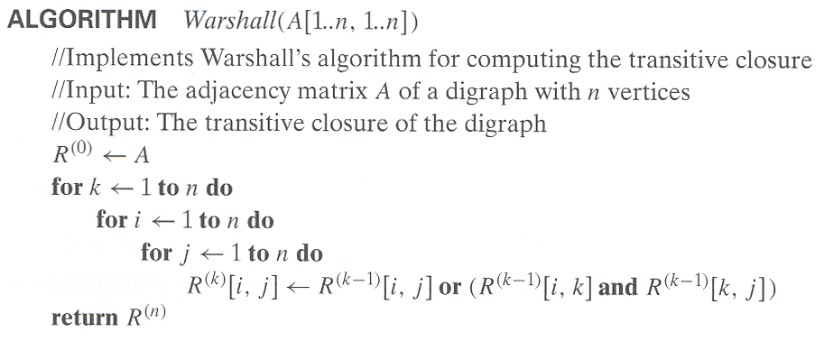
Warshall’s Algorithm (pseudocode and analysis)
Time efficiency: Θ(n³)
Space efficiency: Matrices can be written over their predecessors

Slide 27
Floyd’s Algorithm: All pairs shortest paths
Problem: In a weighted (di)graph, find shortest paths between
every pair of vertices
Same idea: construct solution through series of matrices D⁽⁰⁾, …,
D ^{(n)} using increasing subsets of the vertices allowed
as intermediate
Example:
4
3
1
1
6
1
5
4
2
3

Slide 28
Floyd’s Algorithm (matrix generation)
On the k-th iteration, the algorithm determines shortest paths between every pair of vertices i, j that use only vertices among 1,…,k as intermediate
D^{(k)}[i,j] = min {D^{(k-1)}[i,j], D^{(k-1)}[i,k] + D^{(k-1)}[k,j]}
D^{(k-1)}[i,k]
k
i
D^{(k-1)}[k,j]
D^{(k-1)}[i,j]
j

Slide 30
Floyd’s Algorithm (example)
2
1
2
0 ∞ 3 ∞ 2 0 ∞ ∞
∞ 7 0 1
6 ∞ ∞ 0
0 ∞ 3 ∞
2 0 5 ∞
∞ 7 0 1
6 ∞ 9 0
3
6
7
D⁽⁰⁾ ⁼
D⁽¹⁾ ⁼
3
1
4
0 ∞ 3 ∞
2 0 5 ∞
9 7 0 1
6 ∞ 9 0
0 10 3 4
2 0 5 6
9 7 0 1
6 16 9 0
0 10 3 4
2 0 5 6
7 7 0 1
6 16 9 0
D⁽²⁾ ⁼
D⁽³⁾ ⁼
D⁽⁴⁾ ⁼

Slide 31
Floyd’s Algorithm (example)
2
1
2
0 ∞ 3 ∞ 2 0 ∞ ∞
∞ 7 0 1
6 ∞ ∞ 0
0 ∞ 3 ∞
2 0 5 ∞
∞ 7 0 1
6 ∞ 9 0
3
6
7
D⁽⁰⁾ ⁼
D⁽¹⁾ ⁼
3
1
4
0 ∞ 3 ∞
2 0 5 ∞
9 7 0 1
6 ∞ 9 0
0 10 3 4
2 0 5 6
9 7 0 1
6 16 9 0
0 10 3 4
2 0 5 6
7 7 0 1
6 16 9 0
D⁽²⁾ ⁼
D⁽³⁾ ⁼
D⁽⁴⁾ ⁼

Slide 35
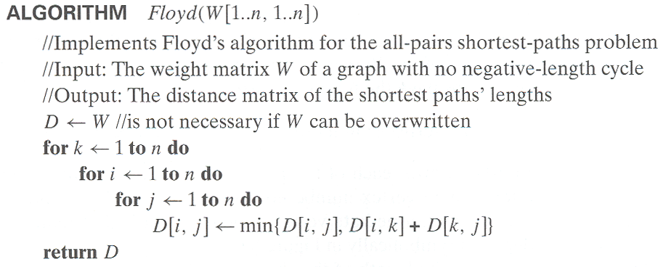
Floyd’s Algorithm (pseudocode and analysis)
Time efficiency: Θ(n³)
Space efficiency: Matrices can be written over their predecessors
Note: Shortest paths themselves can be found, too

Slide 36
Knapsack Problem by DP
Given n items of
  integer weights: w₁ w₂ … w_{n}
  values: v₁ v₂ … v_{n}
a knapsack of integer capacity W
find most valuable subset of the items that fit into the knapsack
Consider instance defined by first i items and capacity j (j ≤ W).
Let V[i,j] be optimal value of such instance. Then
max {V[i-1,j], v_{i} + V[i-1,j- w_{i}]} if j- w_{i} ≥ 0
V[i,j] =
V[i-1,j] if j- w_{i} < 0
Initial conditions: V[0,j] = 0 and V[i,0] = 0

Slide 37
Knapsack capacity=6
Item | Weight | Value
1 | 3 | 20
2 | 2 | 19
3 | 1 | 12
4 | 3 | 22

Slide 44
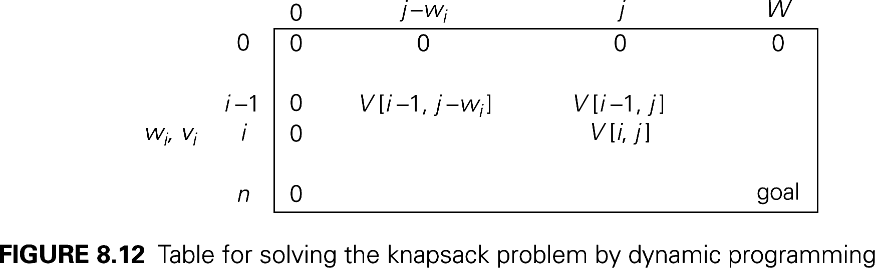

Slide 45
Knapsack Problem by DP (example)
Example: Knapsack of capacity W = 5
item weight value
1 2 $12
2 1 $10
3 3 $20
4 2 $15 capacity j
0 1 2 3 4 5
0
w₁ = 2, v₁= 12 1
w₂ = 1, v₂= 10 2
w₃ = 3, v₃= 20 3
w₄ = 2, v₄= 15 4 ?

Slide 46
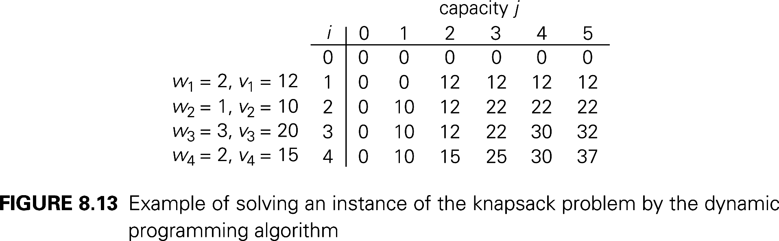
Consider instance defined by first i items and capacity j (j ≤ W).
Let V[i,j] be optimal value of such instance. Then
max {V[i-1,j], v_{i} + V[i-1,j- w_{i}]} if j- w_{i} ≥ 0
V[i,j] =
V[i-1,j] if j- w_{i} < 0
Initial conditions: V[0,j] = 0 and V[i,0] = 0

Slide 47
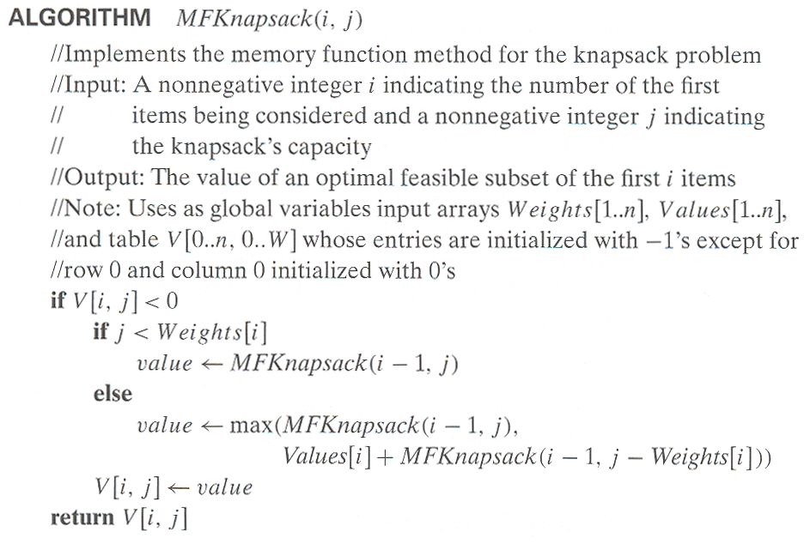

Slide 48
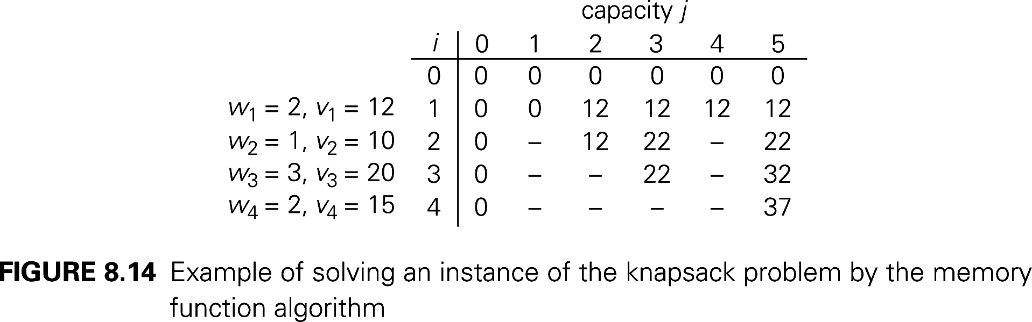

Slide 49
Optimal Binary Search Trees
Problem: Given n keys a₁ < …< a_{n} and probabilities p₁ ≤ … ≤ p_{n}
searching for them, find a BST with a minimum
average number of comparisons in successful search.
Since total number of BSTs with n nodes is given by C(2n,n)/(n+1), which grows exponentially, brute force is hopeless.
Example: What is an optimal BST for keys A, B, C, and D with
search probabilities 0.1, 0.2, 0.4, and 0.3, respectively?

Slide 50
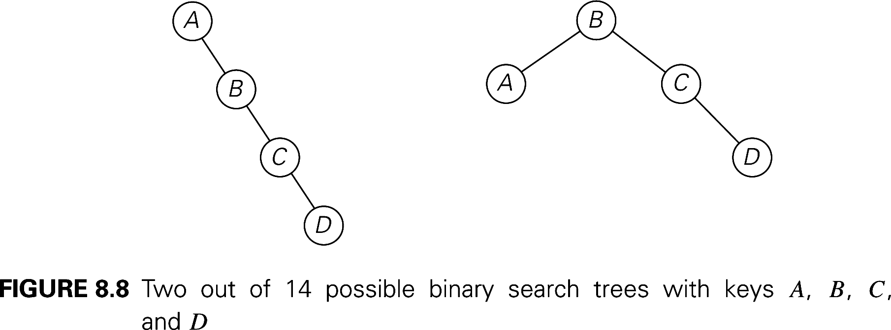

Slide 51
DP for Optimal BST Problem
Let C[i,j] be minimum average number of comparisons made in T[i,j], optimal BST for keys a_{i} < …< a_{j} , where 1 ≤ i ≤ j ≤ n. Consider optimal BST among all BSTs with some a_{k} (i ≤ k ≤ j ) as their root; T[i,j] is the best among them.
C[i,j] =
min {p_{k} · 1 +
∑ p_{s} (level a_{s} in T[i,k-1] +1) +
∑ p_{s} (level a_{s} in T[k+1,j] +1)}
i ≤ k ≤ j
k-1
s = i
j
s =k+1

Slide 52
DP for Optimal BST Problem (cont.)
After simplifications, we obtain the recurrence for C[i,j]:
C[i,j] = min {C[i,k-1] + C[k+1,j]} + ∑ p_{s} for 1 ≤ i ≤ j ≤ n
C[i,i] = p_{i} for 1 ≤ i ≤ j ≤ n
j
i ≤ k ≤ j
s = i

Slide 53
Example: key A B C D
probability 0.1 0.2 0.4 0.3
The tables below are filled diagonal by diagonal: the left one is filled using the recurrence
C[i,j] = min {C[i,k-1] + C[k+1,j]} + ∑ p_{s ,} C[i,i] = p_{i} ;
the right one, for trees’ roots, records k’s values giving the minima
j
i ≤ k ≤ j
s = i
_{i} ^{j}
_{i} ^{j}
 | 0 | 1 | 2 | 3 | 4
1 |  | 1 | 2 | 3 | 3
2 |  |  | 2 | 3 | 3
3 |  |  |  | 3 | 3
4 |  |  |  |  | 4
5
 | 0 | 1 | 2 | 3 | 4
1 | 0 | .1 | .4 | 1.1 | 1.7
2 |  | 0 | .2 | .8 | 1.4
3 |  |  | 0 | .4 | 1.0
4 |  |  |  | 0 | .3
5 |  |  |  |  | 0
C
B
D
A
optimal BST

Slide 62
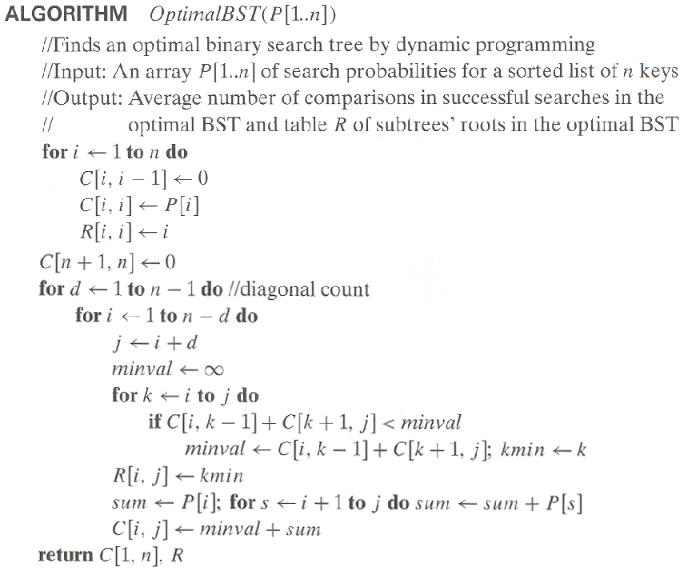
Optimal Binary Search Trees

Slide 63
Analysis DP for Optimal BST Problem
Time efficiency: Θ(n³) but can be reduced to Θ(n²) by taking
advantage of monotonicity of entries in the
root table, i.e., R[i,j] is always in the range
between R[i,j-1] and R[i+1,j]
Space efficiency: Θ(n²)
Method can be expended to include unsuccessful searches

Slide 64
Homework
Exercises 8.4 on page 337
  Question 1, 6, 7

